Slide 1
F.J. REITZ HS
Scheduling for
Junior Year

Slide 2
Presentation Objectives
Review graduation requirements
Review diploma designations
Review the benefits of AP and college credit courses
Discuss course enrollment sheet
Notes:
Today we will review Indiana’s graduation requirements, the types of diplomas you can earn, the benefits of AP and college credit classes, and discuss your 2022-23 course enrollment sheet. Your counselor will visit English classes to meet with students individually and complete course selections. English teachers will notify their classes of the scheduled dates. Please discuss your course selections with your parents and have your “rough draft” enrollment sheet with you on the day of the scheduled meeting with your tentative selections marked.

Slide 3
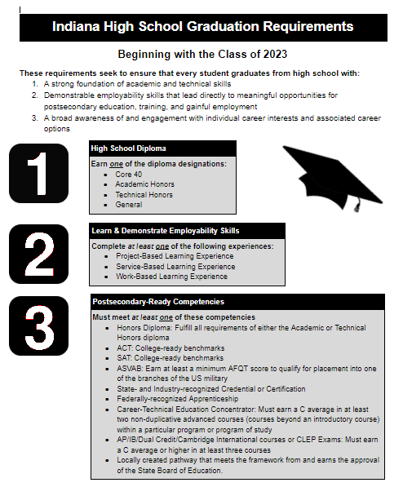
Graduation Requirements
Notes:
In order to graduate high school in the state of Indiana, you must complete the three components of the Indiana Graduation Pathways: diploma, employability skills, and postsecondary readiness. The Graduation Pathways have numerous options to allow students to individualize the pathways to best meet their needs, interests, and postsecondary plans. This slide shows the various options you have to choose from in each of the components. Take note of the second requirement - Employability Skills. You may fulfill this with a service -based school activity such as an athletic sport, marching band, color guard, or theatre. Many students have a job that would fulfill the work-based experience. Your counselor will work with you to ensure you meet one of the third requirements - Postsecondary Ready Competencies.

Slide 4
Current CTE Concentrators at Reitz
Education and Training Pathway
Level 1 Course: Principles of Teaching
Concentrator A: Child and Adolescent Development
Concentrator B: Teaching and Learning
Marketing and Sales Pathway
Level 1 Course: Principles of Business Management
Concentrator A: Marketing Fundamentals
Concentrator B: Strategic Marketing
Human and Social Services Pathway
Level 1 Course: Principles of Human Services
Concentrator A: Understanding Diversity
Concentrator B: Relationships and Emotions
Notes:
If you are not earning an honors diploma or taking 3 or more AP/CC courses, you should enroll in a CTE concentrator to meet bucket 3 of the Graduation Pathway. Each CTE concentrator requires 3 year-long courses. These courses can be taken separately or concurrently. Students must earn a C average in those courses. The current CTE Concentrators at Reitz ar the Education and Training Pathway, Marketing & Sales Pathway, and the Human and Social Services Pathway. Bucket 3 can also be met by earning a certain score on the SAT, ACT, or ASVAB.

Slide 5
Diploma Designations
Core 40
Core 40 w/ Academic Honors
Core 40 w/ Technical Honors
Notes:
There are 3 different diploma designations you can earn in the state of Indiana. We will briefly review each one.

Slide 6
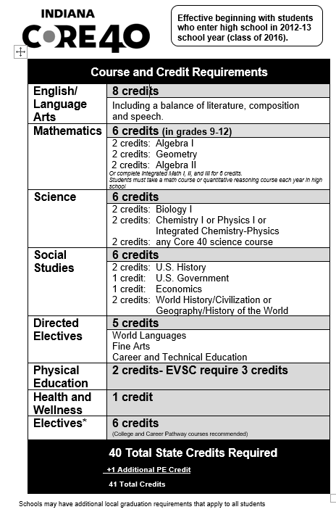
Core 40 Requirements
Core 40 Diploma
English (8)
Math (6)
Science (6)
Social Studies (6)
Directed Electives (5)
PE (2 +1)
Health (1)
Electives (6)
Notes:
A Core 40 diploma represents the minimal requirements needed to gain admission into a 4-year state university. To earn this diploma, students must earn credits in the specific courses/areas noted on this slide. Notice that even though it is called the Core 40 diploma, you must actually earn 41 credits as the EVSC requires an additional PE elective credit.

Slide 7
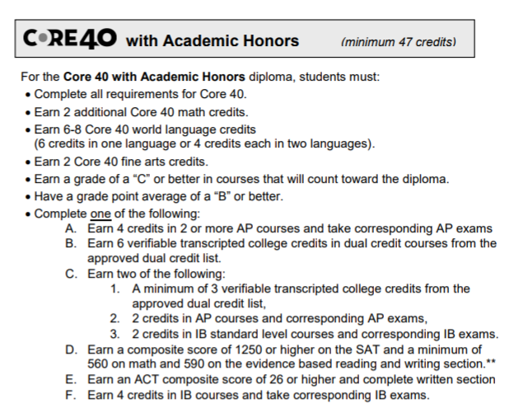
Academic Honors Requirements
Core 40 w/ Academic Honors Diploma
Core 40
Mathematics (+2)
World Language (6-8)
Fine Arts (+2)
Grades (C or better)
GPA (B or better)
AP/CC/SAT/ACT
Notes:
The second designation is an Academic Honors diploma. To earn this diploma, you must earn all the Core 40 requirements and some additional requirements: two more credits in math, three years of one world language or 2 years of 2 different world languages, two fine arts credits, a grade of C or better in required courses, a cumulative GPA of 3.0 or better, and a combination of AP courses, college credit courses, and/or test score benchmarks.

Slide 8
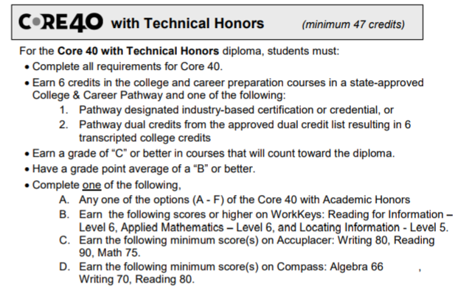
Technical Honors Requirements
Core 40 w/ Technical Honors
Core 40
College & Career Pathway (+6)
Grades (C or better)
GPA (B or better)
AP/CC/SAT/ACT/ Workkeys/Accuplacer
Notes:
The third designation is a Technical Honors diploma. To earn this diploma, you must earn all the Core 40 requirements and some additional requirements: 6 credits in a college and career pathway, a grade of C or better in your courses, a GPA of B (3.0) or better, and a combination of AP courses, college credit courses, and/or test score benchmarks.

Slide 9
What are Advanced Placement (AP) Courses?
The Benefits:
A chance to experience college-level work while still in high school
Research shows that students who take an AP course in high school, regardless of what they scores on the AP exam, are more likely to graduate college in four years.
A chance to earn college credit and placement
Passing an AP exam earns students a minimum 3 college credit or advanced placement in a specific area of study.
Things to Know:
AP courses are on your enrollment sheet with an “AP” in the course title
Any student can enroll in an AP course
Talk with your counselor about your areas of interest and postsecondary plan to determine whether an AP course it right for you!
AP courses are weighted on your high school transcript
For example, earning a “B” in an AP course is like earning an “A” in a non-AP course.
There is a fee to take an AP exam (currently $94) but qualifying students can receive assistance in paying for their exams.
For example, this year the state of Indiana is covering the cost of all English, math, and science AP exams along with the exam fee for any student on free and reduced lunch.
Notes:
On your course enrollment sheet, you will see some courses that say “AP” which stands for Advanced Placement. These are college-level courses in which students can earn college credit dependent on their AP exam score. Research shows that students who take an AP course in high school, regardless of what they score on the AP exam, are more likely to graduate college in four years. AP courses are weighted an additional point. For example, earning a B in an AP course is like earning an A in a non-AP course. If you are interested in taking an AP course, you should speak with your counselor about your career interests and postsecondary plan to determine which AP course is right for you. Do not let the cost of an AP exam hinder your interest in taking an AP course as qualifying students can receive assistance in paying for the exam.

Slide 10
Reitz AP Course Offerings
English
AP English Language & Composition
AP English Literature & Composition
Mathematics
AP Calculus AB
AP Calculus BC
AP Statistics
Science
AP Chemistry
AP Biology
AP Physics I
Social Studies
AP U.S. History
AP World History
AP Psychology
Fine Arts
AP Studio Art 2-D Design
AP Studio Art 3-D Design
AP Music Theory
Notes:
These are the AP courses we currently offer at Reitz.

Slide 11
What are College Credit Courses?
The Benefits:
Chance to experience college-level work while still in high school
Chance to earn college credit
Students earn both high school and college credit during their regular high school day
Things to Know:
College credit courses are noted on the student’s enrollment sheet by a “CC” next to the course title.
Any student can take a college credit course as long as they meet the universities requirements
College credit courses often have a GPA or test score requirement to qualify for enrollment into the course
College credit courses are weighted on your high school transcript.
Each college credit course is weighted an additional half point.
College credit courses are taught by qualified high school instructors in partnership with USI and Ivy Tech.
Some college credit courses have a course fee (often $25 a credit hour) but qualifying students can receive assistance in paying the exam fee.
The course fee is significantly less than what you would pay for the course in college.
Notes:
In addition to AP courses, we also offer college credit courses at Reitz. Through these courses, students earn college and high school credit at the same time, which is why they are also referred to as dual credit courses. College credit courses are weighted an additional half point. For example, a student who earns a B will receive 3.5 points for the course instead of 3. Any student can take a college credit course as long as the student meets the enrollment requirements and completes the application process for the partnering university. These requirements often include a particular GPA or standardized test score. Some college credit courses have a course fee which is often $25 per credit hour. This fee is significantly less than if you paid to take the course in college. Do not let the course fee hinder your decision in taking a college credit course. Qualifying students can receive assistance in paying for the course.

Slide 12
Reitz College Credit Course Offerings
English
Advanced Speech & Communications CC (3 credits)
Mathematics
Pre-Calculus/Trigonometry H CC (6 credits)
Quantitative Reasoning CC (3 credits)
Social Studies
Economics H CC (3 credits)
U. S. Government H CC (3 credits)
World Language
German IV CC (6 credits + 3 USI department credits)
Spanish IV CC (6 credits + 3 USI department credits)
Career & Technical Education (CTE)
PLTW Intro to Engineering Design CC (6 credits)
PLTW Principles of Engineering CC (3 credits)
Business
Digital Applications CC (3 credits)
Computer Illustrations & Graphics CC (3 credits)
Notes:
Here is a list of the college credit courses we currently offer in partnership with either Ivy Tech or USI. Many of these college credits are transferable to other state universities.
REMINDER: Bucket 3 of the Graduation Pathway can be fulfilled by taking 3 AP, college credit, or a combination of AP & college credit courses and earning a C or higher average.

Slide 13
Weighted Grades
Traditional Scale (GPA)
(Regular & Honors Courses)
4.0-A
3.0-B
2.0-C
1.0-D
0-F
College Credit Scale (GPA)
4.5-A
3.5-B
2.5-C
1.5-D
0-F
*For courses with approved final exams
AP Scale (GPA)
5.0-A
4.0-B
3.0-C
2.0-D
0-F
Notes:
Here is a summary of how the different weighted grade GPA scales compare. College credit courses are weighted an additional half point. AP courses are weighted an additional point.

Slide 14
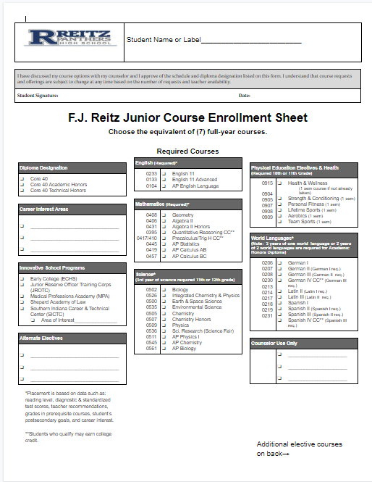
Junior Enrollment Sheet
Notes:
Please have this sheet and a pencil on your desk. Put your name at the top of the sheet.

Slide 15
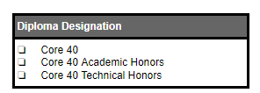
Choose a Diploma Designation
Choose a diploma designation on your enrollment sheet.
Notes:
Now that we have reviewed the different diploma types, mark on your enrollment sheet the diploma designation you plan to earn.

Slide 16
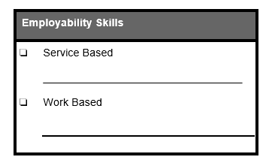
Choose an Employability Skill
Choose an employability skill designation on your enrollment sheet.
Notes:
Some of you will work towards a graduation pathway which requires demonstration of employability skills. If you are a member of an athletic team, marching band, color guard, or theater here at Reitz, you would mark Service Based. Then you would write in the sport or activity. If you have a job or plan to get one, you would mark work-based and enter the name of your place of employment. If you do not currently work or participate in a sport or activity, now is the time to make a plan to meet this requirement.

Slide 17
Choose a Career Interest Area/s
Identify and write at least one career interest area in the corresponding box on your enrollment sheet.
Notes:
Next, identify and write down at least one career interest area on your enrollment sheet. This will help your counselor recommend certain classes that align to your interests and postsecondary plan.

Slide 18
What are EVSC Innovative School Programs?
The Benefits:
Differentiated instruction aligned to student interests
Some programs offer college credit courses not offered at Reitz
Some programs offer Career & Technical Education Certifications not offered at Reitz, which also will help students meet Graduation Pathway requirements.
Things to Know:
These programs (except JROTC) require that students complete an application and be accepted into the program
Juniors typically attend these programs in the morning and Reitz in the afternoon.
Some SICTC classes offer AM and PM courses to juniors
Notes:
The EVSC also has various Innovative school programs such as MPA, Shepard Law, Early College, JROTC, and the Southern Indiana Career and Technical Center. For juniors, these programs typically operate in the morning.

Slide 19
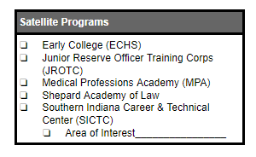
EVSC Innovative School Programs
If you currently attend or plan to apply for an innovative model program, mark the corresponding box on your enrollment form.
SICTC application link:
https://applytosictc.com/
Notes:
If you currently attend or plan to apply for an innovative model program, mark the corresponding box on your enrollment sheet. You can start applying to the innovative school programs today on their websites. The application link to SICTC is applytosictc.com. The programs at the Southern Indiana Career and Technical Center will also meet the Graduation Pathway Bucket 3.

Slide 20
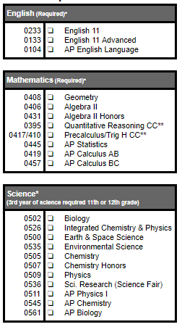
Required Courses for Juniors
Choose an English course
Reminder: Students pursuing an Academic Honors diploma must take English 11A or AP.
Choose a math course
Reminder: You must complete both Geometry & Algebra II before moving into any other math course. If you plan to attend IU, you MUST take Trigonometry.
Choose a science course
You must complete Biology and Chemistry or ICP before choosing your third science course.
Notes:
There are some courses that all seniors must take. English is one of those required courses. If you are pursuing an Academic Honors or a Technical Honors diploma, the EVSC requires that you take English 11A or AP English Language. All juniors also need to choose a math course. You must complete Algebra II and Geometry to fulfill your Core 40 requirements before moving into a higher level math course. You must also choose a science course. You must complete Biology and Chemistry or ICP before choosing your third science. If you have questions about what level of math, English, science, or Social Studies is appropriate for you, please reach out to your current teachers.

Slide 21
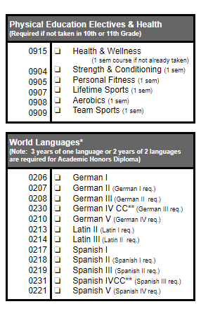
Possible Required Courses
Most PE and Health courses are complete your 9th, 10th, and 11th grade year. However, if you need to take PE I, PE II, Health, or a PE elective, please choose the appropriate course as these are required for graduation.
You may also choose to take additional PE electives courses if you desire.
If you are pursuing an Academic Honors diploma and have not completed 3 years of one language or 2 years of two different languages, you will need to choose the appropriate world language course.
You may also choose to take world language beyond level three if you desire.
Notes:
In addition to English, Math, Social Studies, and Science, you may also need to finish some of your PE and World Language requirements. If you did not take PE I, PE II, Health, and a PE Elective as a 9th or 10th grader, you need to choose the appropriate course on your sheet. Also, if you are pursuing an Academic Honors diploma and have not completed 3 years of one world language or two years of two different languages, you will need to choose the appropriate world language course.

Slide 22
Additional Electives (on back of sheet)
Choose enough electives to make your overall course selections equivalent to 7 full-year courses
Reminder: Some courses are only offered for one semester. You will need to choose 2 one semester courses to equal a full year.
Notes:
Additional electives are on the back of your enrollment sheet. In total, you need to choose the equivalent of 7 full-year courses. Some courses are only offered for one semester, so you will need to choose 2 one semester courses to equal a full year course. Two fine arts credits are required for an Academic Honors Diploma.
A separate presentation will explain all elective options.

Slide 23
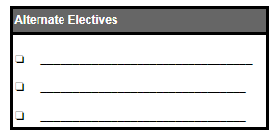
Alternate Electives
Students do not always get the courses they request. This is the result of:
Schedule conflicts
Teacher changes
Lack of interest in a course
Not having the required pre-requisite course(s)
As a result, we need all students to choose 3 alternate electives on their enrollment sheets.
Notes:
Read the slide.

Slide 24
Other Considerations
When choosing your courses, consider the following:
How do I balance my school work and my extracurricular activities?
Am I signing up for too many advanced courses?
Can I challenge myself by taking more advanced courses?
I plan to attend college. Does the college I want to attend have any special requirements for admission (GPA, courses, test scores, etc…)
View the college’s website for admission information
I plan to go straight into the workforce. What classes should I take to prepare myself?
Notes:
Read the slide.

Slide 25
Thank you!
This presentation can be accessed on Google Classroom.
In addition, the presentation, the course enrollment sheets, and a course description guide can be found on the Reitz website.
Notes:
Read the slide.

